Slide 1

초보자를 위한 AI Tutorial
계산과학공학회 겨울학교 2022
Hyungon Ryu | NVIDIA AI Tech Center Korea
hryu@nvidia.com

Slide 2
Agenda
13:30~18:00
Simple Guide to access KISTI Neuron
Slurm, singularity, conda
Example 1 - Regression Problem - Diabetes(당뇨) dataset
MSE, XGBoost, MLP, CNN
Example 2 - Image CLS Problem - MNIST, FashionMNIST
MLP, CNN, ResNet, MLP-Mixer

Slide 3
Simple Neuron Guide

Slide 4
Neuron SSH console access (edu node)
GPU
GPU
GPU
Neuron Login node
GPU node
gpuXX
GPU allocation
ssh access
NFS ( 100T scratch)
console
Neuron Data mover
Labtop

Slide 5
Neuron SSH console access (slurm schedule)
sinfo
squeue
salloc
srun
sbatch
scancel
scancel –u $USER

Slide 6
Example script for slurm
srun -N 1 hostname
srun -N 1 nvidia-smi
srun -N 2 hostname
srun -N 2 nvidia-smi
sinfo
squeue
scancel –u $USER
# Submit the job
! sbatch /scratch/mydir/test_sbatch.sbatch
# Get the JOBID variable
JOBID=!squeue -u $USER | grep dli | awk '{print $1}'
slurm_job_output=' /scratch/mydir/logs/'+JOBID[0]+'.out'
# check the jobs in the SLURM scheduling queue
! squeue
/scratch/mydir/ test_sbatch.sbatch
#!/bin/bash
#SBATCH -N 2
#SBATCH --job-name=hackathon_team01_job
#SBATCH -o /scratch/mydir/logs/%j.out
#SBATCH -e /scratch/mydir/logs/%j.err
srun -l /scratch/mydir/test.sh
/scratch/mydir/test.sh
#!/bin/bash
sleep 2
nvidia-smi
hostname
pwd

Slide 7
Neuron X forwarding for Nsight GUI profiler
Step0. access with X-forwarding(Xshell, Xming, MobaXterm)
Step1. export profile output on NFS
Step2. Launch Ngisht in login-node
Step3. import profile output on NFS
GPU
GPU
GPU
X windows
remoteX
Neuron Login node
GPU node
GPU allocation
ssh access
NFS ( 100T scratch)
console
Neuron Data mover
Labtop

Slide 8
Jupyter on neuron
Local side
Neuron side
ssh
Login node
compute
Launch jupyter server
browser
Jupyter port
Need Port Forwrding
storage
Need Port Forwrding

Slide 9
Neuron Port Forwarding (example)
Step1. allocate GPU ( slurm or interactive)
Step2. launch jupyter in compute node ( check node and available port for GPU)
if you use 8888 port, it crash with other users
Step3. access login node with port forwarding
ssh -L localhost:8888:gpu18:9188 kedu08@neuron.ksc.re.kr
Step4. access jupyter on your local browser
GPU
GPU
neuron:9188
GPU node
Neuron Login node
http://localhost:8888
GPU18:9188
Browser
Jupyter lab
GPU
GPU
Port forwarding
GPU
Neuron Login node
GPU node
Labtop
Slurm schedule
GPU18
GPU allocation
ssh access
NFS ( 100T scratch)
console
Neuron Data mover
Labtop

Slide 10
Singularity image build
Please check your current DevOps Environment
If you use docker, you can duplicate the environment with singularity
If you use conda, you can duplicate the environment ( I’ll skip)
Check pre-built docker image. I prepare images and push it on dockerhub in public
hryu01/pytorch:nlp_v01
hryu01/pytorch:sat_v01
hryu01/pytorch:stylegan3_v01
hryu/nvhpc:2107_nsys
hryu/nvhpc:21.07_cuda11.2
hryu/nvhpc:2105_cuda11.0
hryu | Docker Hub
hryu01 | Docker Hub

Slide 11
Step for build singularity image
docker push
Docker hub
Local system
Kisti Neuron
Docker build
Singulairy module load
Singularity build
Singularity launch
Using docker Hub
Step0. make Dockerfile for docker build
Step1. build docker images on your own system
docker build -t hryu01/pytorch:nlp_v01 -f ../Dockerfile.mynlp .
Step2. push docker image to docker hub
docker push hryu01/pytorch:nlp_v01
Step3. access KISTI Neuron
Step4. load singularity module-environment
module load singularity/3.x.x
Step5. cd scractch folder
Step6. singularity build from docker hub on KISTI Neuron
singularity build --sandbox myimg.sid docker://hryu01/pytorch:nlp_v01
Step7. launch singularity image with --nv option on compute node
singularity run –nv /scratch_folder/myimg.sid nvidia-smi

Slide 12
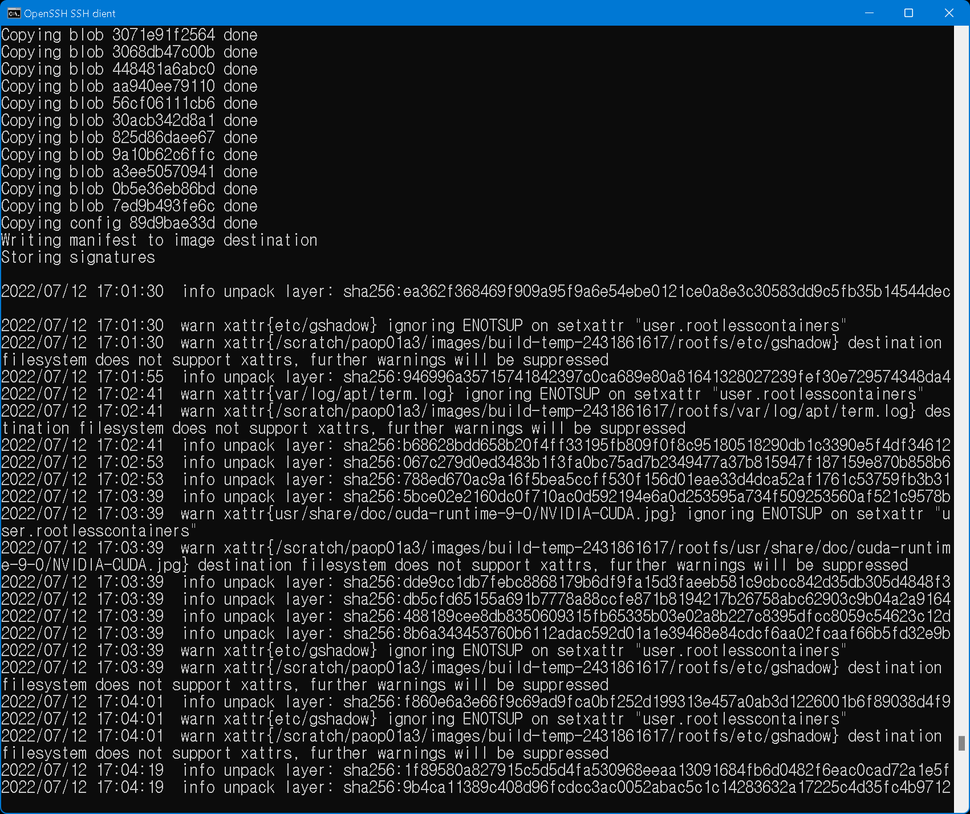
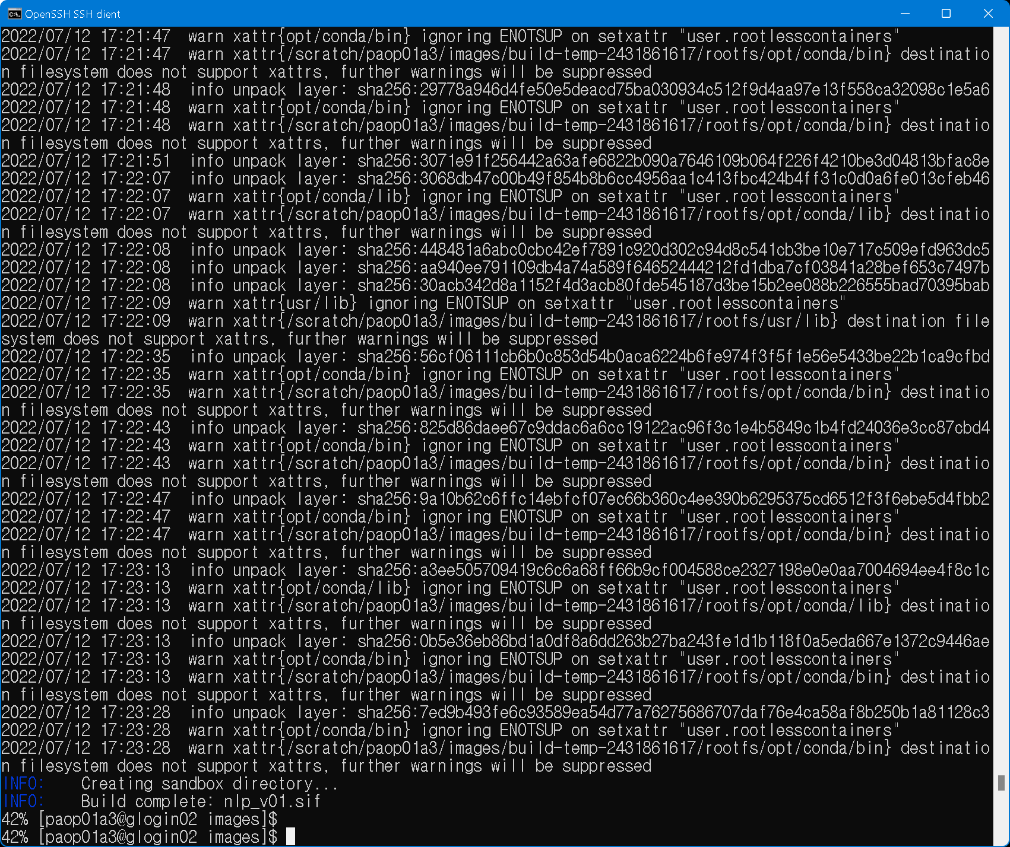
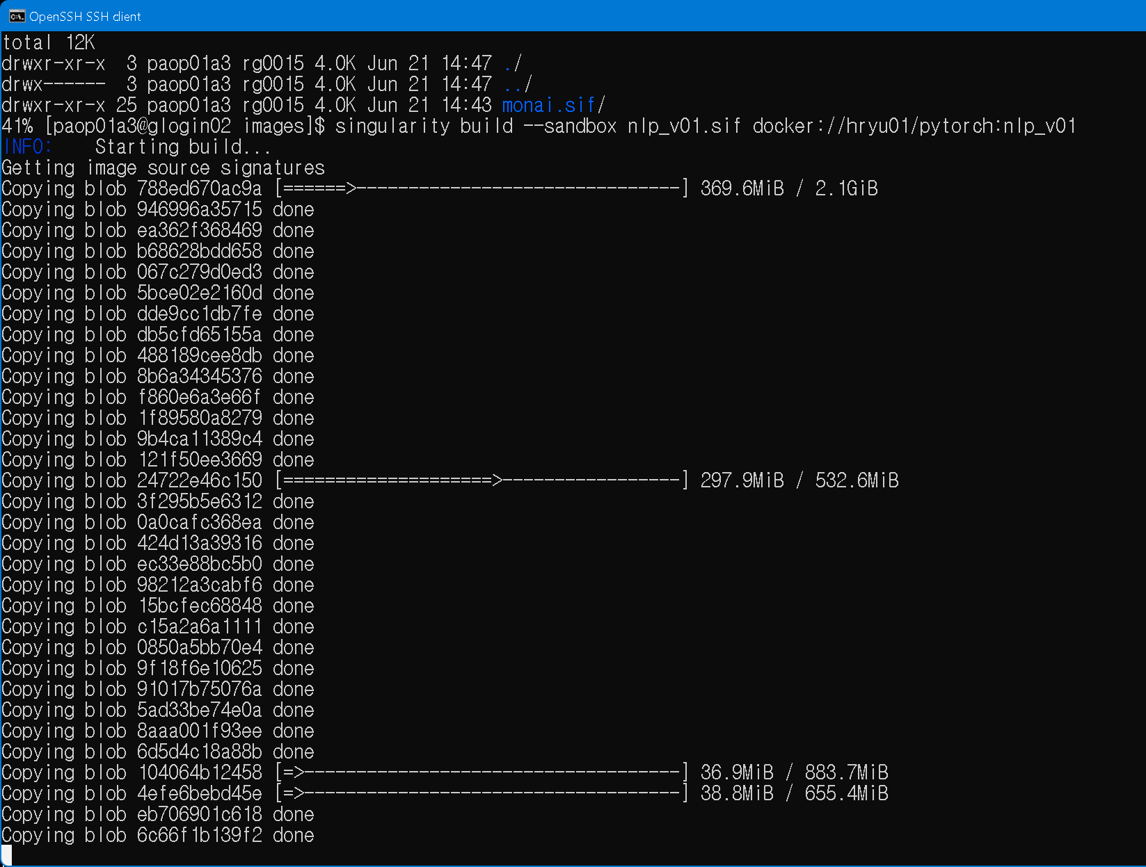
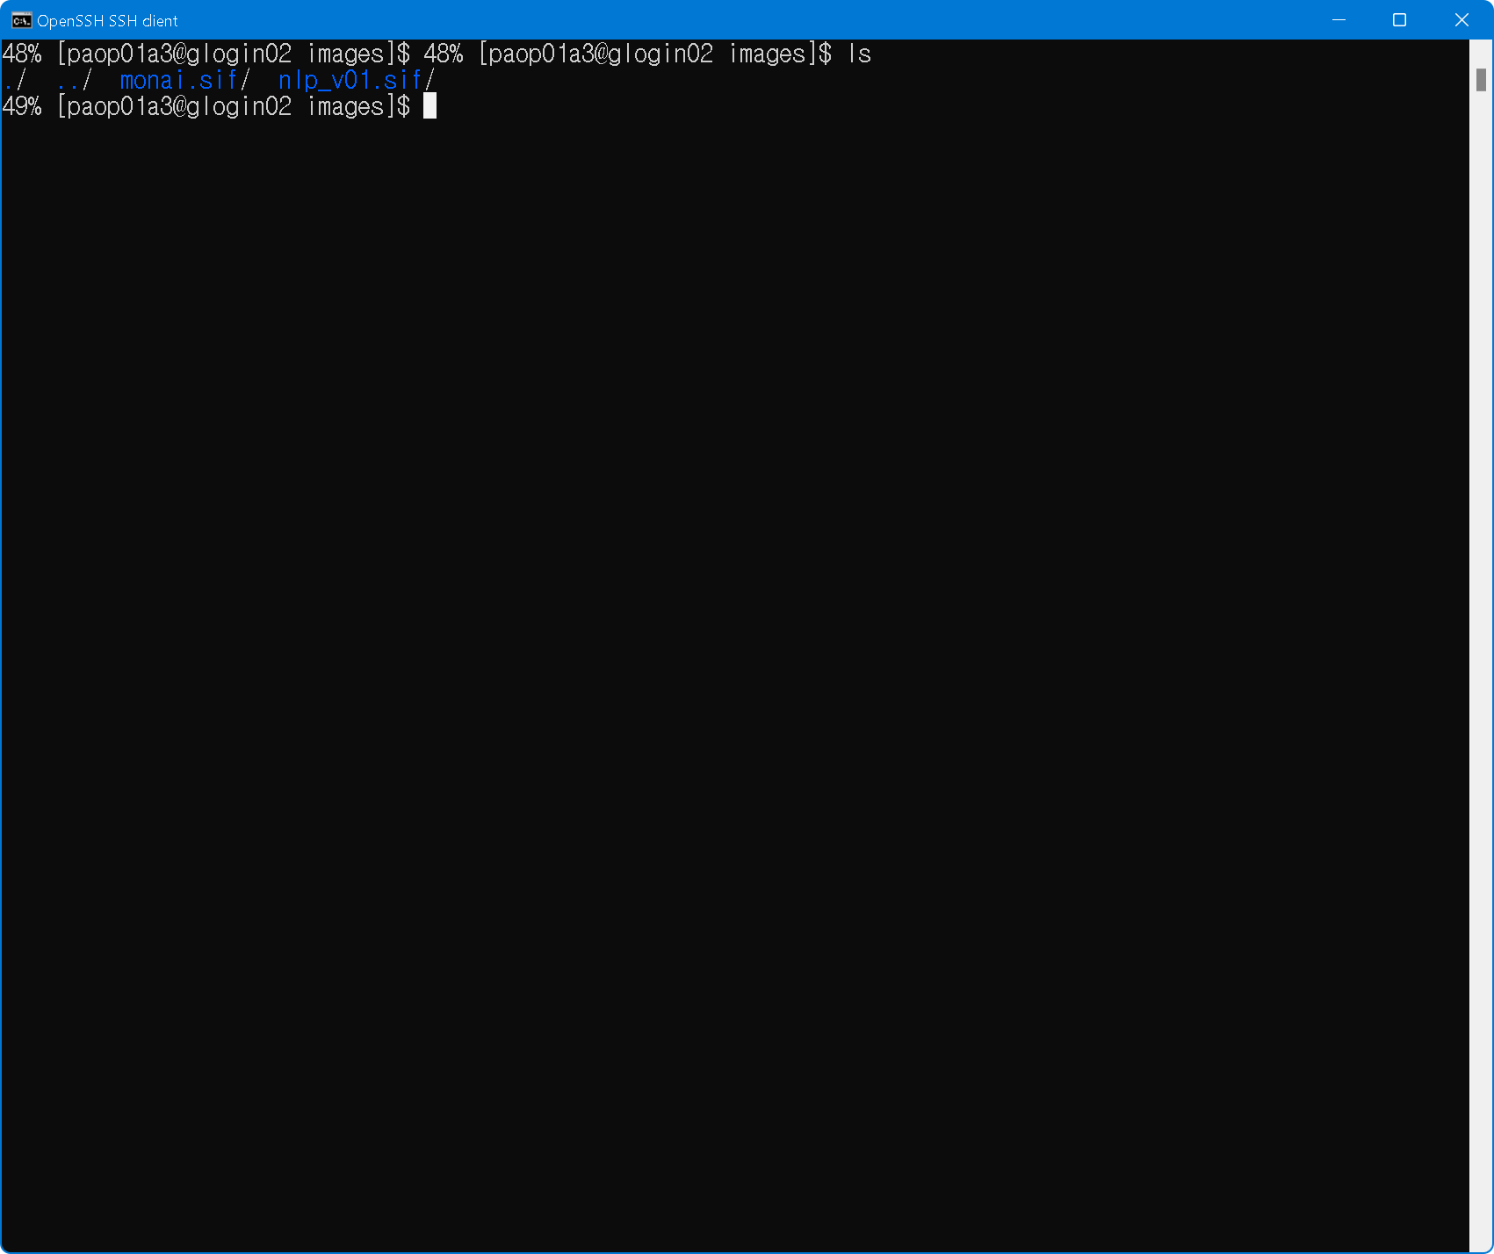
Singularity build on kisti system
cd /scratch/id/work_dir
module load singularity/3.9.7
singularity build --sandbox nlp_v01 docker://hryu01/pytorch:nlp_v01
Sandbox
option
Filename for saving image
docker image
convert
start
Auto download
docker images
done
Singularity
image

Slide 13
Step for build singularity image in local system
Local Linux system
(Ubuntu, WSL2)
KISTI Neuron
Upload singularity image
Docker build
Singularity image convert
Compress singularity image image
uncompress
Singulairy module load
Singularity build
Singularity launch
Using local system
Step1. build docker images on your own system
docker build -t hryu01/pytorch:nlp_v01 -f ../Dockerfile.mynlp .
Step2. build singularity build from local docker image
singularity build --sandbox myimg.sid docker://hryu01/pytorch:nlp_v01
Step3. compress singularity image
tar cvzf myimg.tar.gz myimg.sid
Step4. access KISTI Neuron
Step5. upload singularity image to KISTI Neuron ( data mover node)
Step6. uncompress singularity image
tar xvzf myimg.tar.gz
Step7. load singularity module-environment
module load singularity/3.x.x
Step8. launch singularity image with --nv option on compute node
singularity run –nv /scratch_folder/myimg.sid nvidia-smi

Slide 14
Docker build - Prepare Dockerbuild file
Dockerbuild.medical_v01
FROM nvcr.io/nvidia/pytorch:22.01-py3
# python 3.8 cuda 11.6 pytorch 1.11
ARG DEBIAN_FRONTEND=noninteractive
RUN apt-get update && apt-get install -y git gcc g++ cmake
RUN python -m pip install --upgrade pip
RUN pip install cffi cython hydra-core omegaconf bitarray setuptools gdown
RUN pip install click pillow requests tqdm ninja matplotlib imageio imgui glfw pyopengl imageio-ffmpeg pyspng
RUN pip install numpy pytest regex scipy sklearn tqdm ujson seqeval psutil
RUN pip install pytorch-ignite pytorch-lightning nemo-toolkit
RUN pip install einops
RUN pip install transformers[deepspeed]
RUN pip install openslide-python cucim SimpleITK nibabel
RUN pip install monai monailabel
RUN pip install
WORKDIR /opt
CMD bash
Baseline docker image : NGC 22.01
https://docs.nvidia.com/deeplearning/frameworks/pytorch-release-notes/rel_22-01.html#rel_22-01
install utilities via apt
Pip install utilities
Pip install for medical image

Slide 15
Docker build - Prepare Dockerbuild file custom build example
Example command from Dockerbuild
RUN pip install scikit-build==0.13.1 ## >=0.13.2 have problem with pip --no-binary
# gpu accelerated opencv
WORKDIR /opt
RUN git clone https://github.com/opencv/opencv-python
# 4.55.64 May 04 2022
WORKDIR /opt/opencv-python
RUN git checkout tags/64 # 66
# 6.0 p100 7.0 v100 7.5 t4 8.0 a100/a30 8.6 a2/a10/a16/a40
RUN ENABLE_CONTRIB=1 python setup.py bdist_wheel -- -DWITH_OPENCLAMDFFT=OFF -DWITH_OPENCLAMDBLAS=OFF -DWITH_VA_INTEL=OFF -DWITH_OPENCL=OFF -DWITH_CUDA=ON -DENABLE_FAST_MATH=1 -DCUDA_FAST_MATH=1 -DWITH_CUBLAS=1 -DCUDA_ARCH_BIN='7.0 7.5 8.0 8.6' -- -j 32
RUN ls -lah /opt/opencv-python/dist/*.whl
#RUN pip install /opt/opencv-python/dist/opencv_contrib_python-4.6.0+fcc900e-cp38-cp38-linux_x86_64.whl # latest 30 june
#RUN pip install /opt/opencv-python/dist/opencv_contrib_python-4.6.0.66-cp38-cp38-linux_x86_64.whl #tags/66
RUN pip install /opt/opencv-python/dist/opencv_contrib_python-4.5.5.64-cp38-cp38-linux_x86_64.whl # tags/64
Change work directory
Git clone
Git checkout with tag
Custom build with 32 CPU cores
Pip install from built wheel

Slide 16
Docker build - Prepare Dockerbuild file dual docker image example
FROM nvcr.io/nvidia/tritonserver:21.02-py3 as triton
FROM nvcr.io/nvidia/clara-train-sdk:v4.0
WORKDIR /opt
RUN pip3 install --upgrade pip && \
pip3 install --upgrade wheel setuptools docker && \
pip3 install --upgrade grpcio-tools grpcio-channelz numpy
COPY --from=triton /opt/tritonserver /opt/tritonserver
RUN ln -s /usr/local/cuda-11.2/targets/x86_64-linux/lib/stubs/libnvidia-ml.so /opt/tritonserver/lib/libnvidia-ml.so.1
Use two docker images
Copy file from inside of docker images
Symbolic link

Slide 17
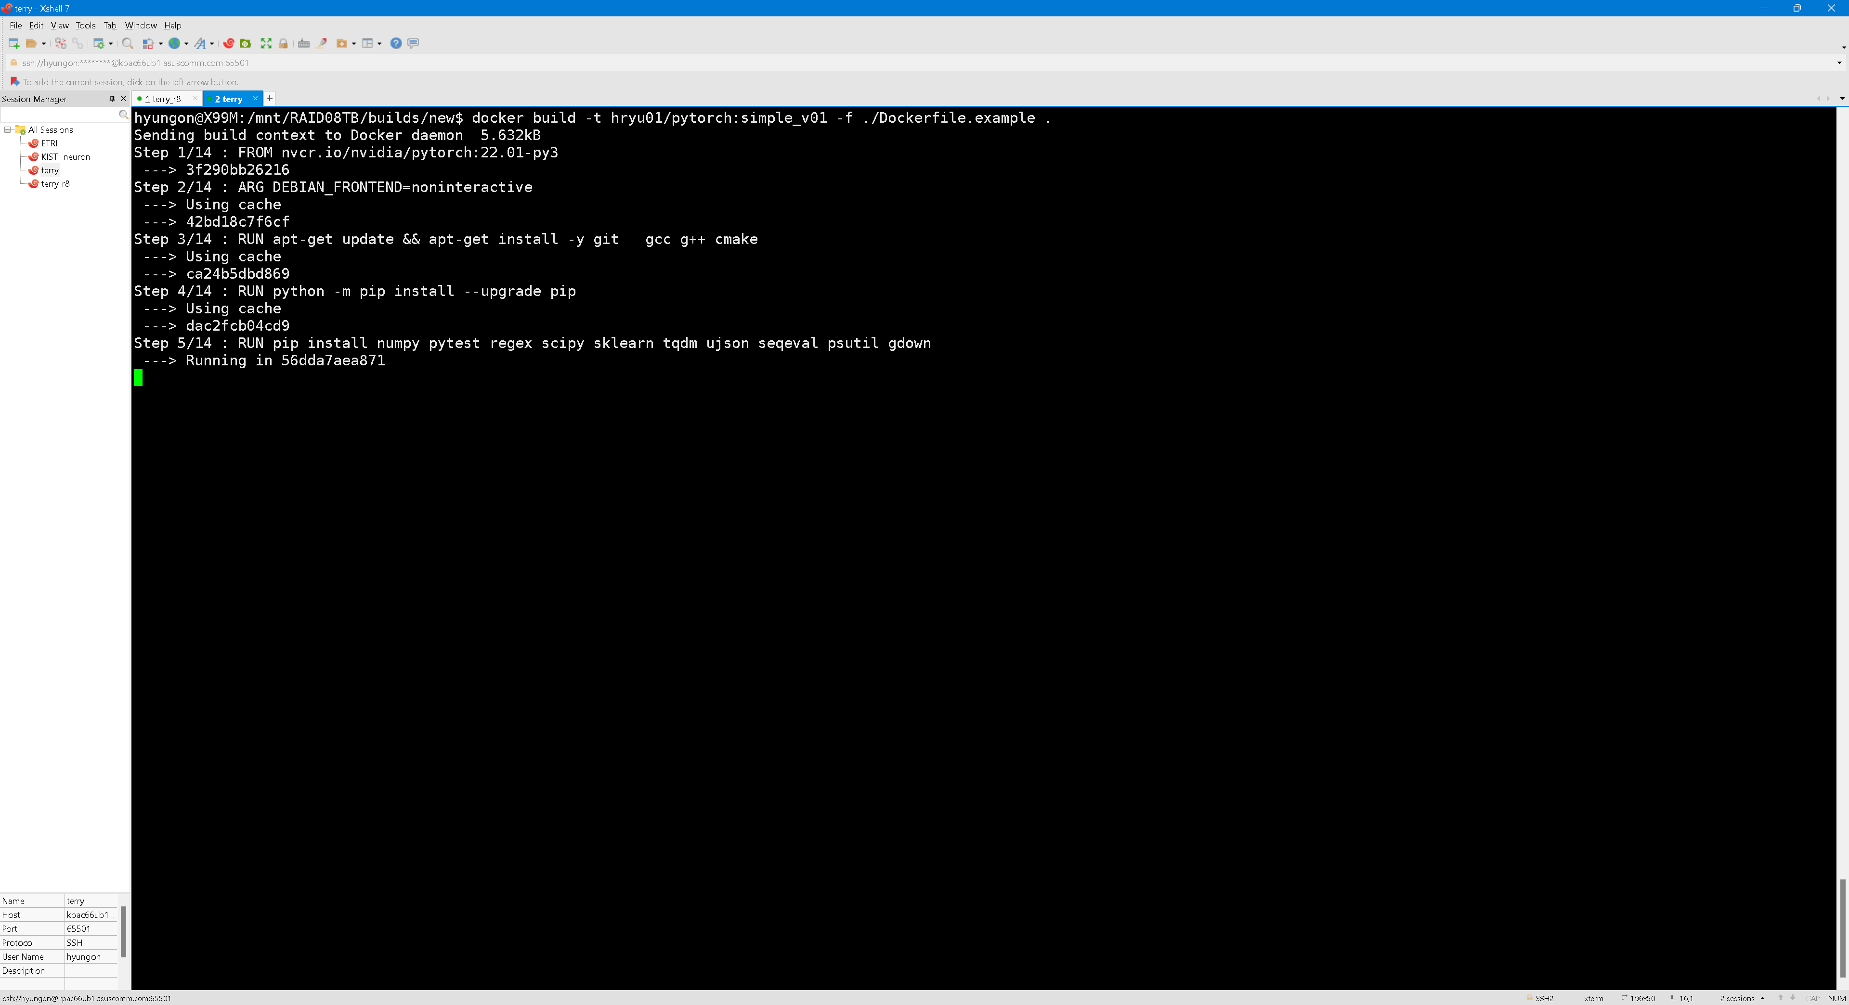
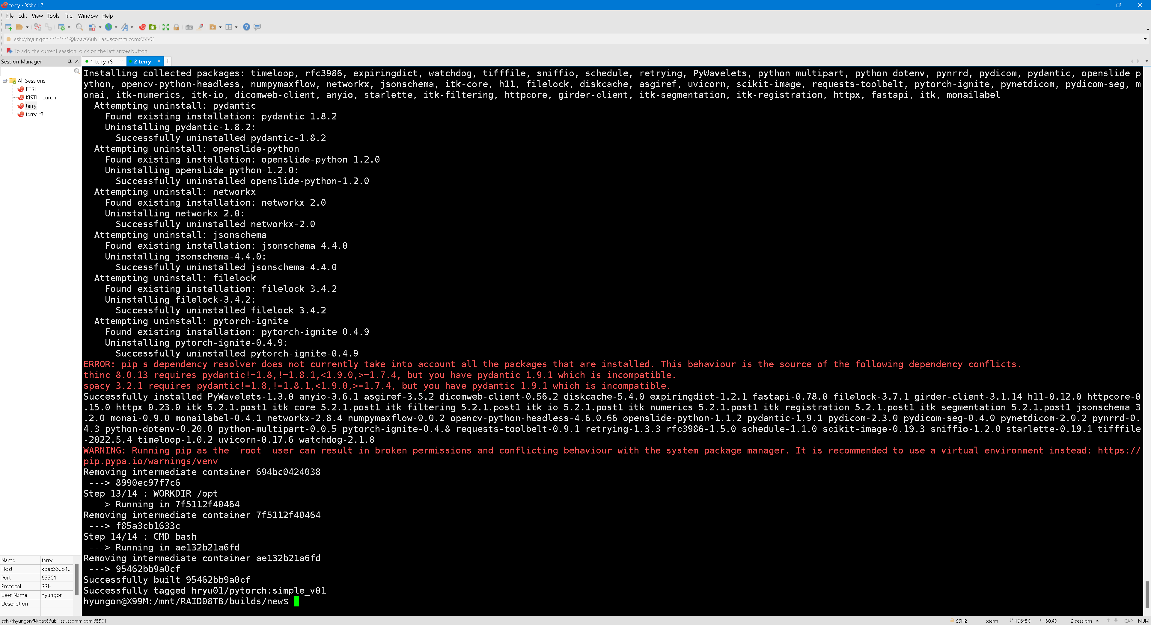
Docker build on local machine
docker build -t hryu01/pytorch:simple_v01 -f ./Dockerfile.example .
Docker image tag
Docker build script file
Build location

Slide 18
Contents
Jupyter
https://github.com/yhgon/bootcamp_kr/tree/main/2022/12_KSCE_22_AI
https://colab.research.google.com/drive/1kQclwFBlkWQ6-_0hE-VFRVKMzdMHtzqc?usp=sharing
DLI X-lab
Register
https://courses.nvidia.com/dli-event/
Event code :
Contents https://courses.nvidia.com/courses/course-v1:DLI+X-FX-11+V1/course/

Slide 19
Example1
regression

Slide 20
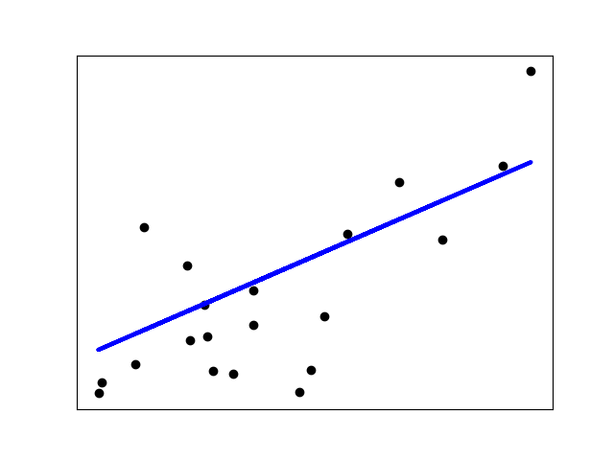
Example 1 – Diabetes dataset regression
Diabetes dataset
original dataset
number of observation : 442
X , 10 variables
age, age in years
sex
bmi, body mass index
bp, average blood pressure
s1 tc, total serum cholesterol
s2 ldl, low-density lipoproteins
s3 hdl, high-density lipoproteins
s4 tch, total cholesterol / HDL
s5 ltg, possibly log of serum triglycerides level
s6 glu, blood sugar level
Y, quantitative measure of disease progression one year after baseline

Slide 21
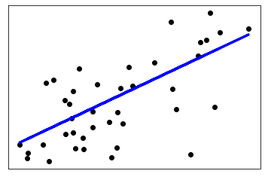
Python script
from sklearn import linear_model
from sklearn.metrics import mean_squared_error, r2_score
# Create linear regression object
regr = linear_model.LinearRegression()
regr.fit(diabetes_X_train, diabetes_y_train)
diabetes_y_pred = regr.predict(diabetes_X_test)

Slide 22
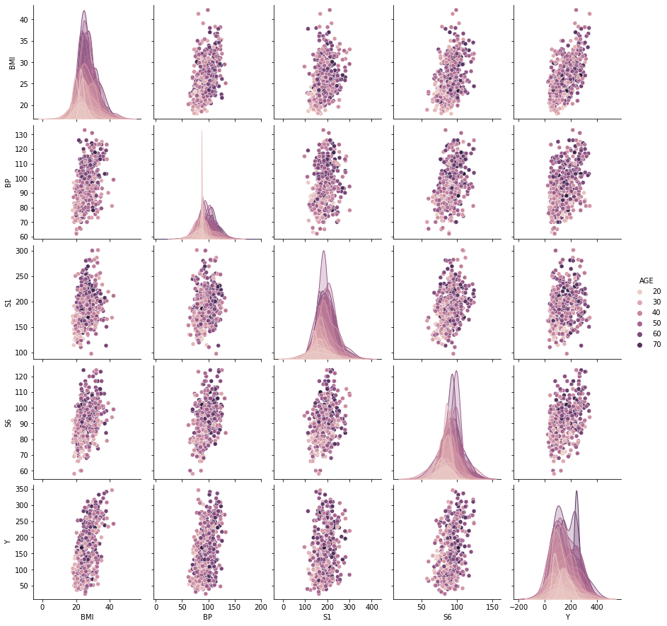
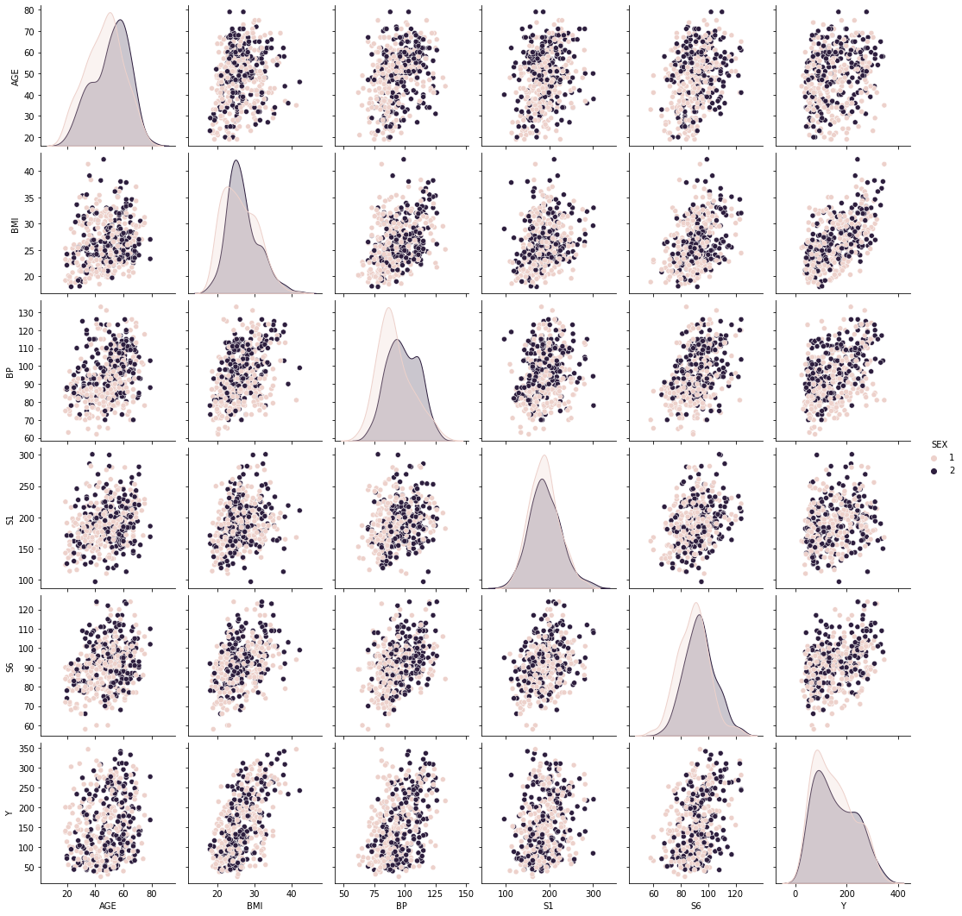
sns.pairplot
sns.pairplot(df[["AGE", 'SEX' , "BMI", "BP", "S1", "S6", "Y"]] , hue='SEX')
sns.pairplot(df[["AGE", "BMI", "BP", "S1", "S6", "Y"]] , hue='AGE')

Slide 23
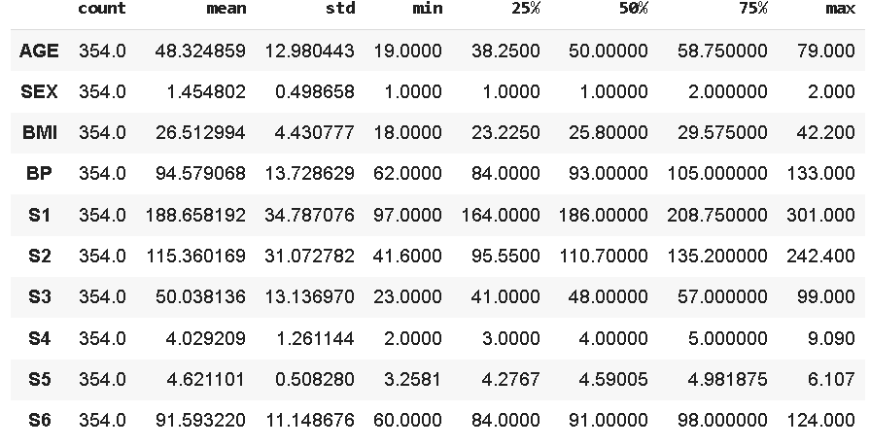
Preprocess(normalizing)
train_stats = df_train.describe()
train_stats.pop("Y")
train_stats = train_stats.transpose()
train_stats
def norm(x):
return (x - train_stats['mean']) / train_stats['std’]
df_train_normalized = norm(df_train)
df_test_normalized = norm(df_test)

Slide 24
Define model (MLP)
Our model has three layers:
10 input features (10 variables)
512 nodes in the hidden layer (feel free to experiment with this value)
1 output nodes to denote the class
import tensorflow as tf
from tensorflow import keras
from tensorflow.keras import layers
model = keras.Sequential([
layers.Input( shape=[len(df_train.keys())] ) ,
layers.Dense(512, activation='relu'),
layers.Dense(1) # regression
])

Slide 25
Compile
Before the model is ready for training, it needs a few more settings. These are added during the model's compile step:
Loss function —This measures how accurate the model is during training. You want to minimize this function to "steer" the model in the right direction. See KERAS's loss functions section
Optimizer —This is how the model is updated based on the data it sees and its loss function. See Keras Optimizer Section
Metrics —Used to monitor the training and testing steps. The following example uses accuracy, the fraction of the images that are correctly classified. See Keras's Metrics section
model.compile(loss='mse',
optimizer='adam',
metrics=['mae', 'mse'])

Slide 26
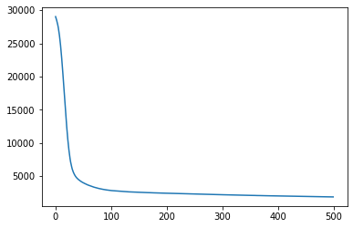
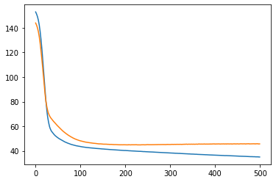
train
hist = model.fit(
df_train_normalized, train_labels,
epochs=500, validation_split = 0.2, verbose=0 ,
callbacks=[PrintDot()] )

Slide 27
One hot encoding
AGE SEX BMI BP S1 S2 S3 S4 S5 S6 Y 0 59 2 32.1 101.0 157 93.2 38.0 4.0 4.8598 87 151 1 48 1 21.6 87.0 183 103.2 70.0 3.0 3.8918 69 75 2 72 2 30.5 93.0 156 93.6 41.0 4.0 4.6728 85 141 3 24 1 25.3 84.0 198 131.4 40.0 5.0 4.8903 89 206 4 50 1 23.0 101.0 192 125.4 52.0 4.0 4.2905 80 135
df_train = pd.get_dummies(df_train, columns=['SEX'], prefix='SEX')
df_test = pd.get_dummies(df_test, columns=['SEX'], prefix='SEX')

Slide 28
XGBoost
import xgboost as xgb
xg_reg = xgb.XGBRegressor()
xg_reg.fit(df_train_normalized, train_labels)

Slide 29
CNN(Convolution Neural Network)
model = keras.Sequential([
layers.Input( shape= (num_variables,num_dim ) ) ,
layers.Conv1D(filters=128, kernel_size=3, activation='relu', name="Conv1D_1"),
#layers.MaxPooling1D(pool_size=2, name="MaxPooling1D_1"),
layers.Dropout(0.2),
layers.Conv1D(filters=128, kernel_size=3, activation='relu', name="Conv1D_2"),
#layers.MaxPooling1D(pool_size=2, name="MaxPooling1D_2"),
layers.Dropout(0.2),
layers.Flatten(),
layers.Dense(512, activation='relu'),
layers.Dropout(0.2),
layers.Dense(512, activation='relu'),
layers.Dropout(0.2),
layers.Dense(128, activation='relu'),
layers.Dense(1)
])

Slide 30
Example2
Image Classification

Slide 31
Example2 – Image CLS Problem
Machine Learning Pipeline
During the bootcamp we will be making use of the following concepts to help us understand how a machine learning (ML) project should be planned and executed:
Data: To start any ML project we need data which is pre-processed and can be fed into the network.
Task: There are many possible tasks in the field of ML; we need to make sure we understand and define the problem statement accurately.
Model: We need to build our model, which is neither too deep (requiring a lot of computational power) nor too small (preventing it from learning the important features).
Loss: Out of the many loss functions that can be defined, we need to carefully choose one which is suitable for the task we are about to carry out.
Learning: There are a variety of optimisers, each with their advantages and disadvantages. We must choose one which is suitable for our task and train our model using some suitably chosen hyperparameters.
Evaluation: We must determine if our model has learned the features properly by analysing how it performs on data it has not previously seen.

Slide 32
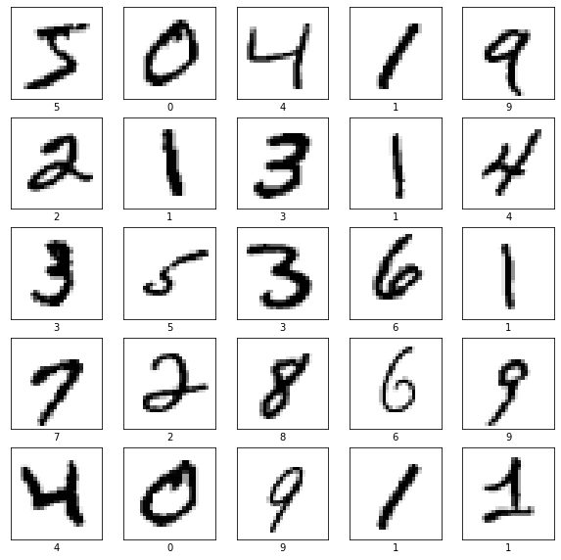
Dataset MNIST
# TensorFlow and tf.keras
import tensorflow as tf
from tensorflow import keras
from tensorflow.keras.datasets import mnist
# the data, split between train and validation sets
(x_train, y_train), (x_valid, y_valid) = mnist.load_data()

Slide 33
preprocessing
x_train = x_train.reshape(60000, 784) # 28x28 = 784
x_valid = x_valid.reshape(10000, 784)
x_train = x_train / 255
x_valid = x_valid / 255

Slide 34
End-to-End pipeline with MLP model
from tensorflow.keras.models import Sequential
from tensorflow.keras.layers import Dense
model = Sequential()
model.add(Dense(units=512, activation='relu', input_shape=(784,)))
model.add(Dense(units = 512, activation='relu'))
model.add(Dense(units = 10, activation='softmax'))
model.summary()
model.compile(optimizer='adam',
loss='sparse_categorical_crossentropy',
metrics=['accuracy’])
hist = model.fit(
x_train, y_train, epochs=5, verbose=1
)
test_loss, test_acc = model.evaluate(x_valid, y_valid, verbose=2)
predictions = model.predict(x_valid)
Define model
Compile model
train model
Evaluate and predict

Slide 35
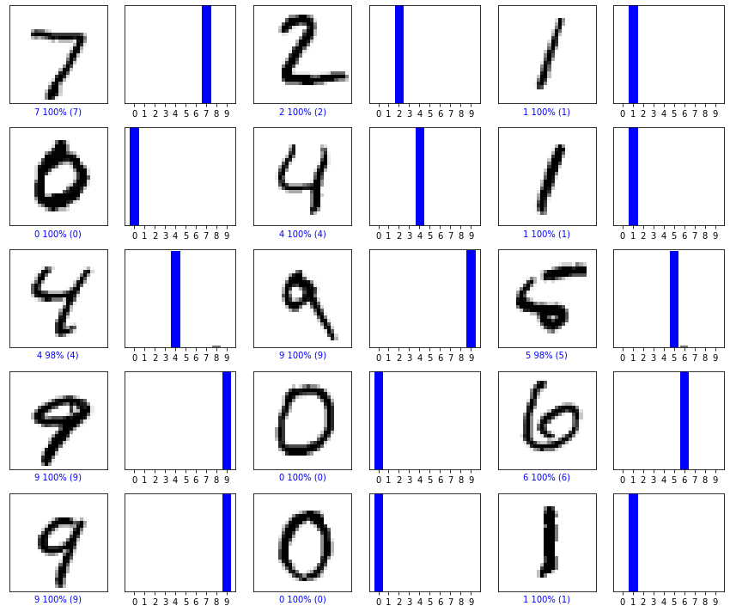

Slide 36
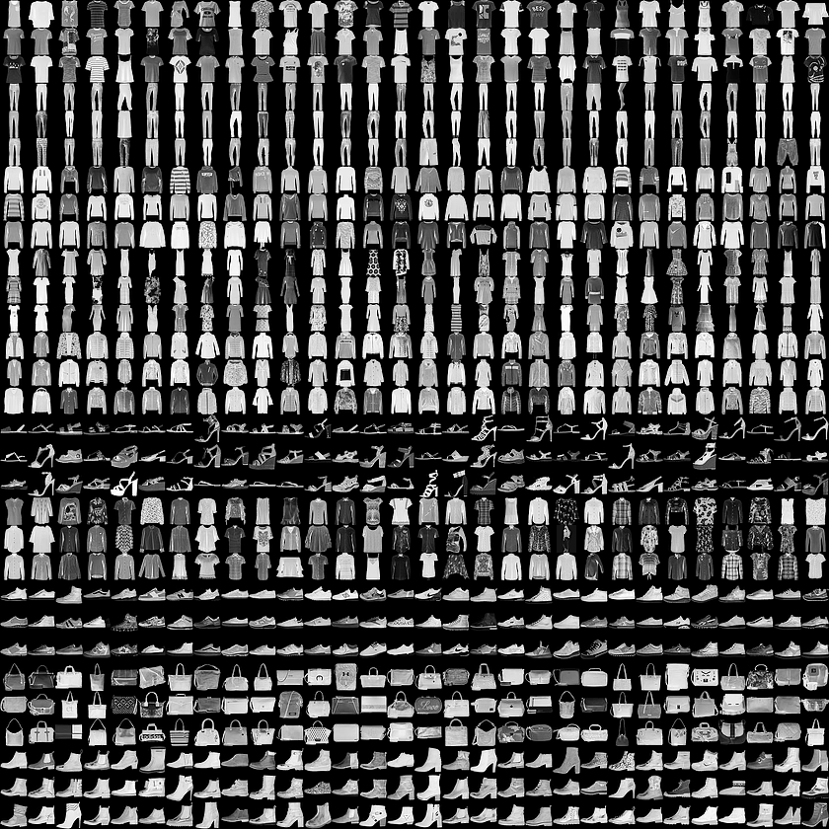
Fashion MNST dataset
# TensorFlow and tf.keras
import tensorflow as tf
from tensorflow import keras
fashion_mnist = keras.datasets.fashion_mnist
(train_images, train_labels), (test_images, test_labels) = fashion_mnist.load_data()

Slide 37
preprocessing
class_names = ['T-shirt/top', 'Trouser', 'Pullover', 'Dress', 'Coat',
'Sandal', 'Shirt', 'Sneaker', 'Bag', 'Ankle boot’]
train_images = train_images / 255.0
test_images = test_images / 255.0
# Reshape input data from (28, 28) to (28, 28, 1)
w, h = 28, 28
train_images = train_images.reshape(train_images.shape[0], w, h, 1)
test_images = test_images.reshape(test_images.shape[0], w, h, 1)

Slide 38
Convolution
Convolution Layer
We will be using the following API to define the Convolution Layer.
tf.keras.layers.Conv2D(filters, kernel_size, padding='valid', activation=None, input_shape)
Let us briefly define the parameters:
filters: The dimensionality of the output space (i.e. the number of output filters in the convolution).
kernel_size: An integer or tuple/list of 2 integers, specifying the height and width of the 2D convolution window. Can be a single integer to specify the same value for all spatial dimensions.
padding: One of "valid" or "same" (case-insensitive).
activation: Activation function to use (see activations). If you don't specify anything, no activation is applied (i.e. "linear" activation: a(x) = x).
Pooling Layer
tf.keras.layers.MaxPooling2D(pool_size=2)
pool_size: Size of the max pooling window. Documentation: Pooling Layers
Dropout
Dropout is an approach to regularization in neural networks which helps reduce interdependent learning amongst the neurons.
Simply put, dropout refers to ignoring units (i.e. neurons) during the training phase, with a certain set of neurons chosen at random. By “ignoring," we mean these units are not considered during a particular forward or backward pass.
It is defined by the following function:
tf.keras.layers.Dropout(0.3)
Parameter: Fraction of the input units to drop (float between 0 and 1). Documentation: Dropout

Slide 39
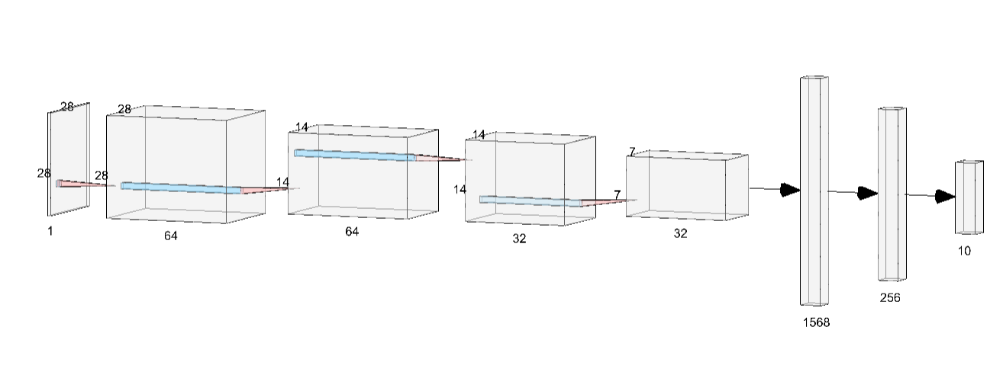
Define CNN
from tensorflow.keras import backend as K
import tensorflow as tf
K.clear_session()
model = tf.keras.Sequential()
# Must define the input shape in the first layer of the neural network
model.add(tf.keras.layers.Conv2D(filters=32, kernel_size=3, padding='same', activation='relu', input_shape=(28,28,1)))
model.add(tf.keras.layers.MaxPooling2D(pool_size=2))
# model.add(tf.keras.layers.Dropout(0.3))
# Second convolution layer
model.add(tf.keras.layers.Conv2D(filters=64, kernel_size=3, padding='same', activation='relu'))
model.add(tf.keras.layers.MaxPooling2D(pool_size=2))
model.add(tf.keras.layers.Dropout(0.3))
# Fully connected layer
model.add(tf.keras.layers.Flatten())
model.add(tf.keras.layers.Dense(128, activation='relu'))
model.add(tf.keras.layers.Dropout(0.5))
model.add(tf.keras.layers.Dense(10, activation='softmax'))
# Take a look at the model summary
model.summary()

Slide 40
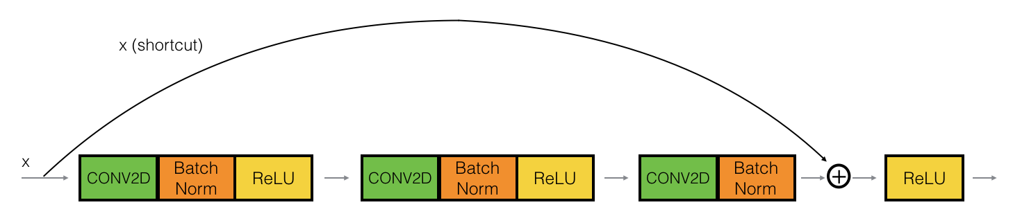
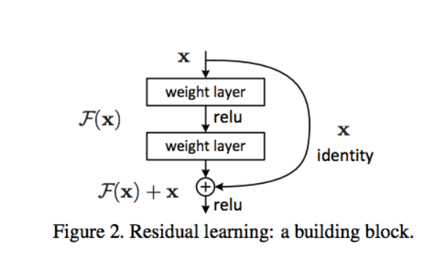
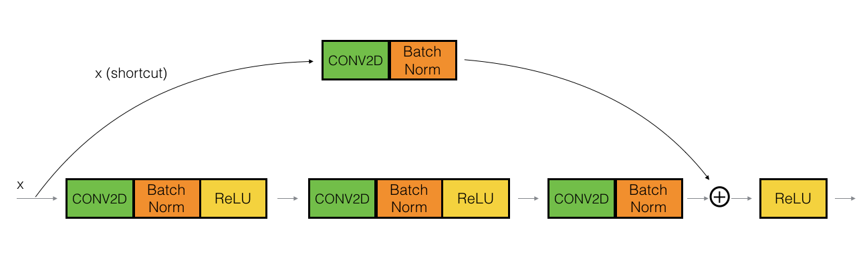
ResNet
Identity
Block
Convolution
Block

Slide 41
ResNet
def ResNet(input_shape = (28, 28, 1), classes = 10): # Define the input as a tensor with shape input_shape
X_input = Input(shape=input_shape)
# Zero-Padding
X = ZeroPadding2D((3, 3))(X_input)
# Stage 1
X = Conv2D(64, (3, 3), strides = (2, 2), name = 'conv1', kernel_initializer = glorot_uniform(seed=0))(X)
X = BatchNormalization(axis = 3, name = 'bn_conv1')(X)
X = Activation('relu')(X)
X = MaxPooling2D((3, 3), strides=(2, 2))(X)
# Stage 2
X = convolutional_block(X, f = 3, filters = [64, 64, 256], stage = 2, block='a', s = 1)
X = identity_block(X, 3, [64, 64, 256], stage=2, block='b')
X = identity_block(X, 3, [64, 64, 256], stage=2, block='c')
# Stage 3
X = convolutional_block(X, f=3, filters=[128, 128, 512], stage=3, block='a', s=2)
X = identity_block(X, 3, [128, 128, 512], stage=3, block='b')
X = identity_block(X, 3, [128, 128, 512], stage=3, block='c')
X = identity_block(X, 3, [128, 128, 512], stage=3, block='d')
# AVGPOOL
X = AveragePooling2D(pool_size=(2,2), padding='same')(X)
# Output layer
X = Flatten()(X)
X = Dense(classes, activation='softmax', name='fc' + str(classes), kernel_initializer = glorot_uniform(seed=0))(X)
# Create model
model = Model(inputs = X_input, outputs = X, name='ResNet')
return model

Slide 42
Identity block
def identity_block(X, f, filters, stage, block):
# Defining name basis
conv_name_base = 'res' + str(stage) + block + '_branch'
bn_name_base = 'bn' + str(stage) + block + '_branch'
# Retrieve filters
F1, F2, F3 = filters
# A path is a block of conv followed by batch normalization and activation
# Save the input value
X_shortcut = X
# First component of main path
X = Conv2D(filters = F1, kernel_size = (1, 1), strides = (1,1), padding = 'valid', name = conv_name_base + '2a', kernel_initializer = glorot_uniform(seed=0))(X)
X = BatchNormalization(axis = 3, name = bn_name_base + '2a')(X)
X = Activation('relu')(X)
# Second component of main path
X = Conv2D(filters = F2, kernel_size = (f, f), strides = (1, 1), padding = 'same', name = conv_name_base + '2b', kernel_initializer = glorot_uniform(seed=0))(X)
X = BatchNormalization(axis = 3, name = bn_name_base + '2b')(X)
X = Activation('relu')(X)
# Third component of main path
X = Conv2D(filters = F3, kernel_size = (1, 1), strides = (1, 1), padding = 'valid', name = conv_name_base + '2c', kernel_initializer = glorot_uniform(seed=0))(X)
X = BatchNormalization(axis = 3, name = bn_name_base + '2c')(X)
# Final step: Add shortcut value to main path, and pass it through a RELU activation
X = Add()([X, X_shortcut])
X = Activation('relu')(X)
return X

Slide 43
Convolution Block
def convolutional_block(X, f, filters, stage, block, s=2): # Defining name basis
conv_name_base = 'res' + str(stage) + block + '_branch'
bn_name_base = 'bn' + str(stage) + block + '_branch'
# Retrieve filters
F1, F2, F3 = filters
# Save the input value
X_shortcut = X
##### MAIN PATH #####
# First component of main path
X = Conv2D(filters=F1, kernel_size=(1, 1), strides=(s, s), padding='valid', name=conv_name_base + '2a', kernel_initializer=glorot_uniform(seed=0))(X)
X = BatchNormalization(axis=3, name=bn_name_base + '2a')(X)
X = Activation('relu')(X)
# Second component of main path
X = Conv2D(filters=F2, kernel_size=(f, f), strides=(1, 1), padding='same', name=conv_name_base + '2b', kernel_initializer=glorot_uniform(seed=0))(X)
X = BatchNormalization(axis=3, name=bn_name_base + '2b')(X)
X = Activation('relu')(X)
# Third component of main path
X = Conv2D(filters=F3, kernel_size=(1, 1), strides=(1, 1), padding='valid', name=conv_name_base + '2c', kernel_initializer=glorot_uniform(seed=0))(X)
X = BatchNormalization(axis=3, name=bn_name_base + '2c')(X)
##### SHORTCUT PATH ####
X_shortcut = Conv2D(filters=F3, kernel_size=(1, 1), strides=(s, s), padding='valid', name=conv_name_base + '1', kernel_initializer=glorot_uniform(seed=0))(X_shortcut)
X_shortcut = BatchNormalization(axis=3, name=bn_name_base + '1')(X_shortcut)
# Final step: Add shortcut value to main path, and pass it through a RELU activation
X = Add()([X, X_shortcut])
X = Activation('relu')(X) return X

Slide 44
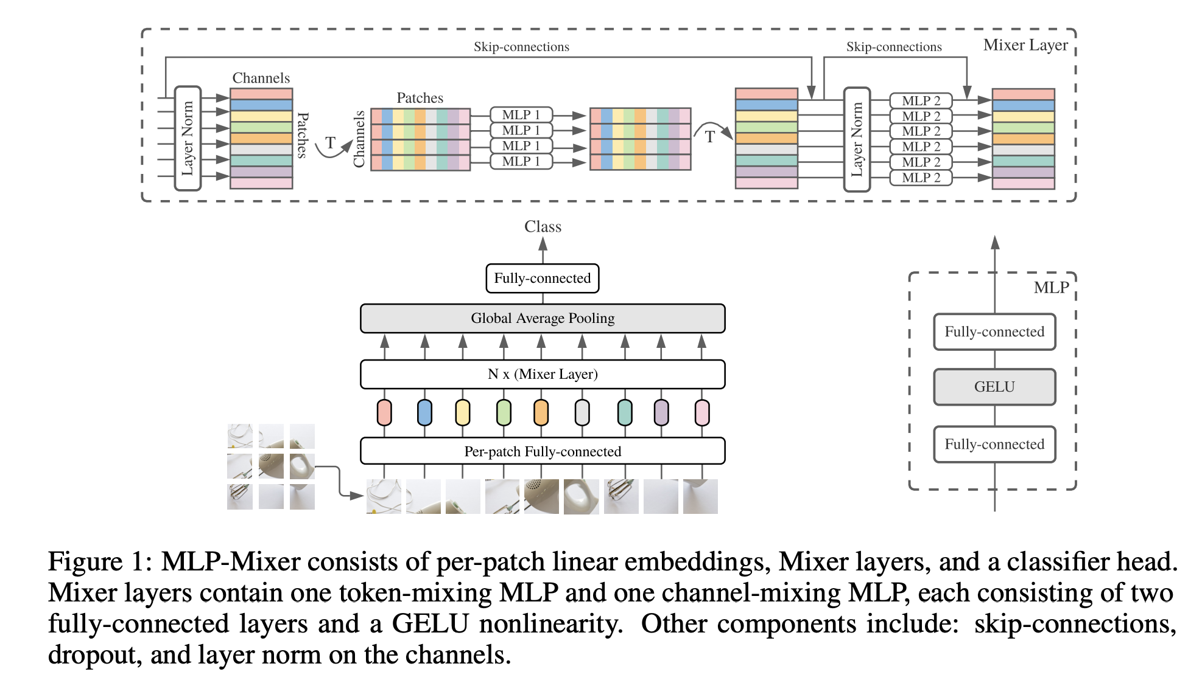
MLP-Mixer

Slide 45
MLP-Mixer
def MlpMixerModel(
input_shape: int,
num_classes: int,
num_blocks: int,
patch_size: int,
hidden_dim: int,
tokens_mlp_dim: int,
channels_mlp_dim: int = None,
use_softmax: bool = False,
):
height, width, _ = input_shape
if channels_mlp_dim is None:
channels_mlp_dim = tokens_mlp_dim
num_patches = (height*width)//(patch_size**2) # TODO verify how this behaves with same padding
inputs = keras.Input(input_shape)
x = inputs
x = Conv2D(hidden_dim,
kernel_size=patch_size,
strides=patch_size,
padding='same',
name='projector')(x)
x = keras.layers.Reshape([-1, hidden_dim])(x)
for _ in range(num_blocks):
x = MixerBlock(num_patches=num_patches,
channel_dim=hidden_dim,
token_mixer_hidden_dim=tokens_mlp_dim,
channel_mixer_hidden_dim=channels_mlp_dim)(x)
x = GlobalAveragePooling1D()(x) # TODO verify this global average pool is correct choice here
x = LayerNormalization(name='pre_head_layer_norm')(x)
x = Dense(num_classes, name='head')(x)
if use_softmax:
x = Softmax()(x)
return keras.Model(inputs, x)

Slide 46
MLP Block
from tensorflow import keras
from tensorflow.keras.layers import ( Add, Dense, Conv2D, GlobalAveragePooling1D, Layer, LayerNormalization, Permute, Softmax, Activation,)
class MlpBlock(Layer):
def __init__(
self,
dim: int,
hidden_dim: int,
activation=None,
**kwargs
):
super(MlpBlock, self).__init__(**kwargs)
if activation is None:
activation = keras.activations.gelu
self.dim = dim
self.hidden_dim = dim
self.dense1 = Dense(hidden_dim)
self.activation = Activation(activation)
self.dense2 = Dense(dim)
def call(self, inputs):
x = inputs
x = self.dense1(x)
x = self.activation(x)
x = self.dense2(x)
return x
def compute_output_shape(self, input_signature):
return (input_signature[0], self.dim)
def get_config(self):
config = super(MlpBlock, self).get_config()
config.update({
'dim': self.dim,
'hidden_dim': self.hidden_dim })
return config

Slide 47
Mixer Block
class MixerBlock(Layer):
def __init__(
self,
num_patches: int,
channel_dim: int,
token_mixer_hidden_dim: int,
channel_mixer_hidden_dim: int = None,
activation=None,
**kwargs
):
super(MixerBlock, self).__init__(**kwargs)
self.num_patches = num_patches
self.channel_dim = channel_dim
self.token_mixer_hidden_dim = token_mixer_hidden_dim
self.channel_mixer_hidden_dim = channel_mixer_hidden_dim
self.activation = activation
if activation is None:
self.activation = keras.activations.gelu
if channel_mixer_hidden_dim is None:
channel_mixer_hidden_dim = token_mixer_hidden_dim
self.norm1 = LayerNormalization(axis=1)
self.permute1 = Permute((2, 1))
self.token_mixer = MlpBlock(num_patches, token_mixer_hidden_dim, name='token_mixer')
self.permute2 = Permute((2, 1))
self.norm2 = LayerNormalization(axis=1)
self.channel_mixer = MlpBlock(channel_dim, channel_mixer_hidden_dim, name='channel_mixer')
self.skip_connection1 = Add()
self.skip_connection2 = Add()
def call(self, inputs):
x = inputs
skip_x = x
x = self.norm1(x)
x = self.permute1(x)
x = self.token_mixer(x)
x = self.permute2(x)
x = self.skip_connection1([x, skip_x])
skip_x = x
x = self.norm2(x)
x = self.channel_mixer(x)
x = self.skip_connection2([x, skip_x]) # TODO need 2?
return x
def compute_output_shape(self, input_shape):
return input_shape
def get_config(self):
config = super(MixerBlock, self).get_config()
config.update({
'num_patches': self.num_patches,
'channel_dim': self.channel_dim,
'token_mixer_hidden_dim': self.token_mixer_hidden_dim,
'channel_mixer_hidden_dim': self.channel_mixer_hidden_dim,
'activation': self.activation,
})
return config

Slide 48
Train MLP-Mixer
# Reshape input data from (28, 28) to (28, 28, 1)
w, h = 28, 28
train_images = train_images.reshape(train_images.shape[0], w, h, 1)
test_images = test_images.reshape(test_images.shape[0], w, h, 1)
model_mlp_mixer = MlpMixerModel(input_shape=train_images.shape[1:],
num_classes=len(np.unique(train_labels)),
num_blocks=4,
patch_size=4,
hidden_dim=64,
tokens_mlp_dim=128,
channels_mlp_dim=128,
use_softmax=True)
model_mlp_mixer.compile(optimizer='adam',
loss='sparse_categorical_crossentropy',
metrics=['accuracy’])
hist = model_mlp_mixer.fit(train_images, train_labels, validation_data=(test_images, test_labels), epochs = 10, batch_size = 128 )

Slide 49
Blank

